Slide 1
Investigating the Rate of Change of Microplastics in our Oceans

Slide 2
In this presentation, we will answer:
What are the limitations of the research?
How have the concentrations of microplastics increased or decreased in the oceans over time?
Is microplastic accumulation higher in the Atlantic or the Pacific Ocean?
After looking at the data, what are things we need to consider before drawing any conclusions?

Slide 3
What are the Limitations of the Research?
Only one source of data:
National Centers for Environmental Information
Lack of context
No reasons for the particular locations of the measurements
Multiple types of sampling methods
Aluminum bucket vs. Manta Net and so on
Different filter sizes

Slide 4
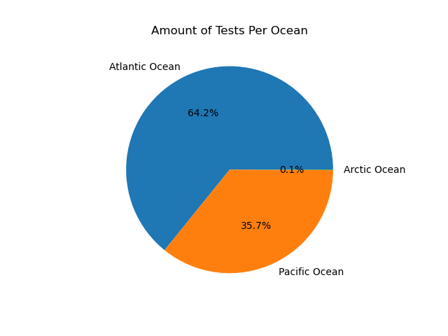
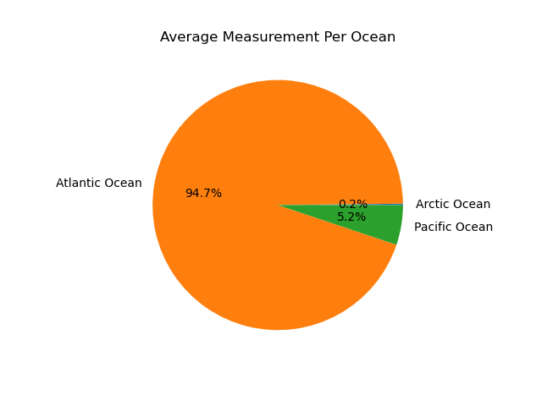
Number of Tests per Ocean vs Mean Measurement(pieces/m³) Amount Per Ocean
Notes:
This is the amount of tests taken per ocean vs the mean measurement per ocean. So the most tests were taken in the atlantic

Slide 5
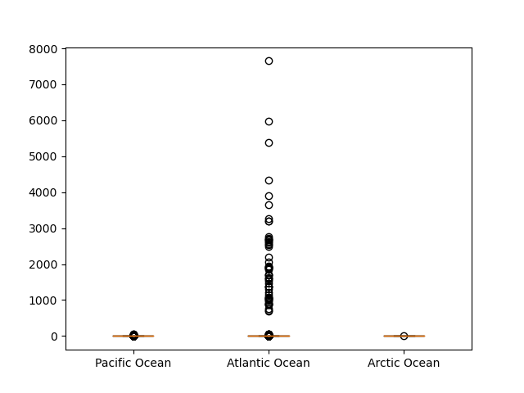
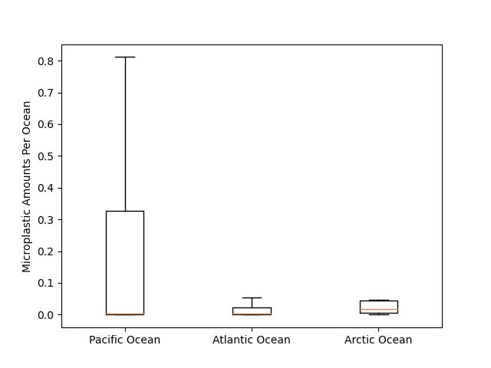
Boxplots of Microplastic Amount Per Ocean With Outliers vs Without Outliers
Notes:
This is boxplots for the microplastic measurements per year. In the second plot we took out outliers to get a better look at the data. Left boxplot includes outlier which by taking a glance, shows how skewed the data becomes (this will be explained later as these are the Brazil/aluminum bucket readings) Right boxplot shows more accurately the rest of the sample measurements and how they have much smaller recordings ranging from 0 - 0.8 pieces/m^3

Slide 6
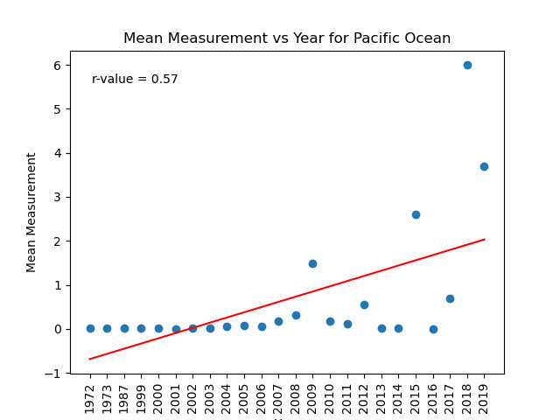
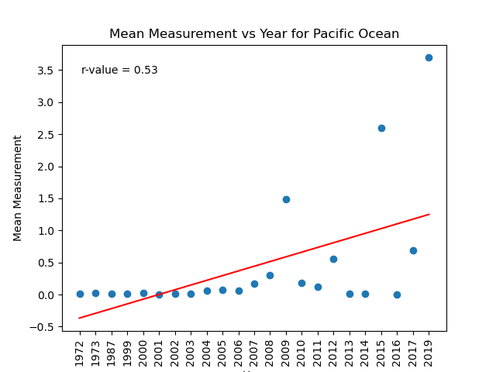
Are the levels of microplastics increasing in the Pacific ocean?
Notes:
All data for pacific vs removing 2018. we see there is a moderate correlation here. but once again the line doesnt fit that great because of some weird outliers, even excluding the 2018 aluminum bucket data

Slide 7
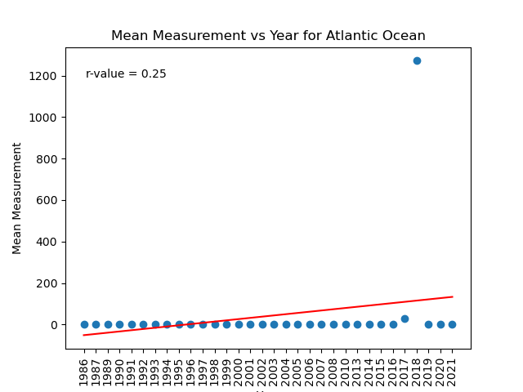
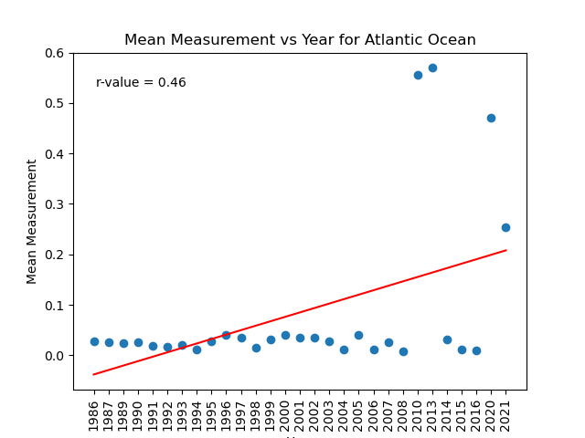
Are the levels of microplastics increasing in the Atlantic ocean?
Notes:
Left is all data. Right is data without 2017,2018, and 2019 outlier data. mention that the line does not provide a great fit for the data. removing the outlier data creates a bit higher of a correlation, but we should still be hesitant to make an conclusions based on this data

Slide 8
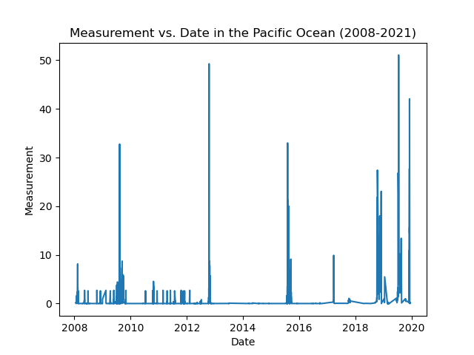
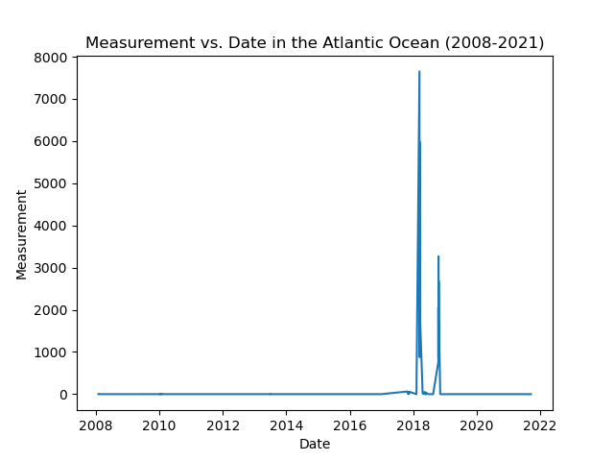
Taking a Closer Look at 2008-2021 for both Oceans
Notes:
There seems to be here no specific pattern in microplastics over time, when looking closer at the years where levels start to pick up a bit. But the levels mostly stay consistent other than outliers

Slide 9
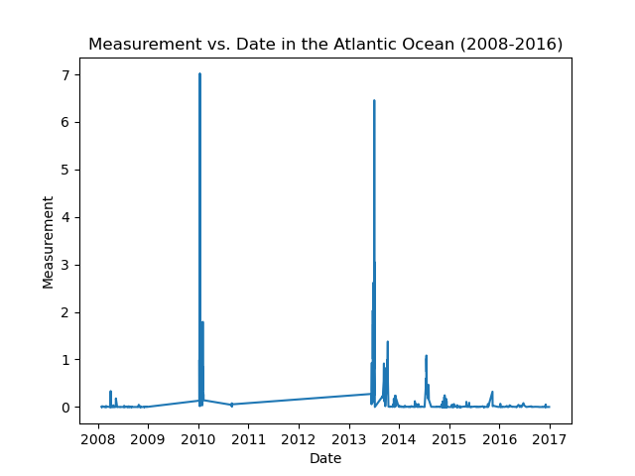
Looking at the Atlantic from 2008-2016
Notes:
I thought that taking a closer look at where the data starts to rise and excluding outlier years, would give us a clearer picture. But there seems to be little outliers as you get closer. It is hard to draw any direct conclusions from this data, but we tend to see more spikes in numbers as time goes on.

Slide 10
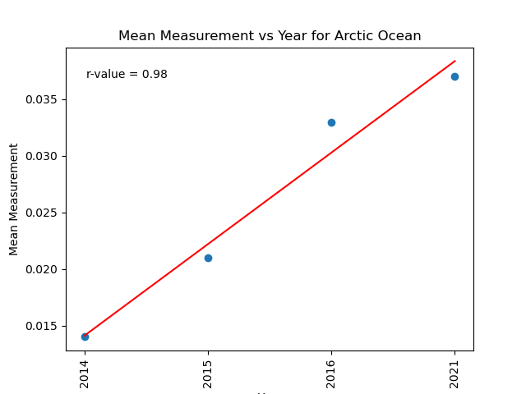
Are the levels of microplastics increasing in the Arctic ocean?
Notes:
Since there were only 4 samples included in the data from the Arctic ocean, we see a much clearer picture here. It is important to note however, that the last sample was taken 5 years after the previous sample. But from this data we can see that there is clearly a rise of microplastics in the Arctic ocean with a high correlation.

Slide 11
Question 1 Conslusion
Although there are some moderate correlations seen within the data, I believe that the inconsistent testing methods across the data which result in huge outliers leaves us unable to say definitively if microplastic levels are rising in the Pacific Ocean and Atlantic Ocean.
The levels in the Arctic ocean are clearly rising, but there is very little tests done from that ocean.

Slide 12
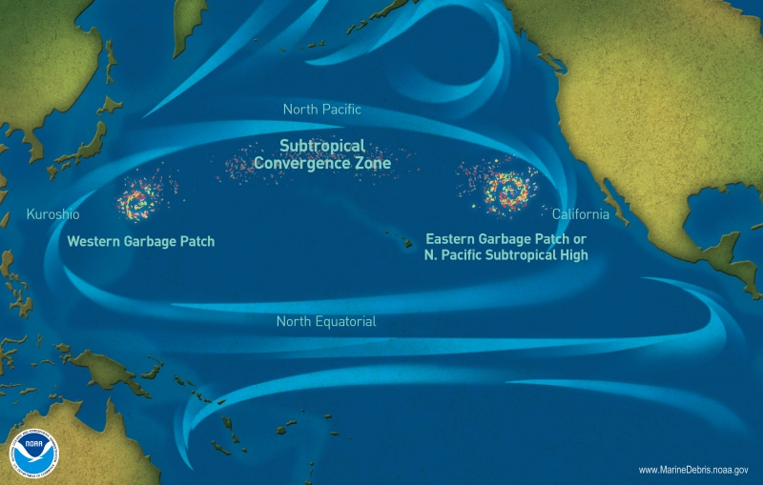
Is microplastic accumulation higher in the Atlantic or the Pacific Ocean?
5 gyres in the Ocean.
1 in the Indian Ocean.
2 in the Atlantic Ocean.
2 in the Pacific Ocean.

Slide 13
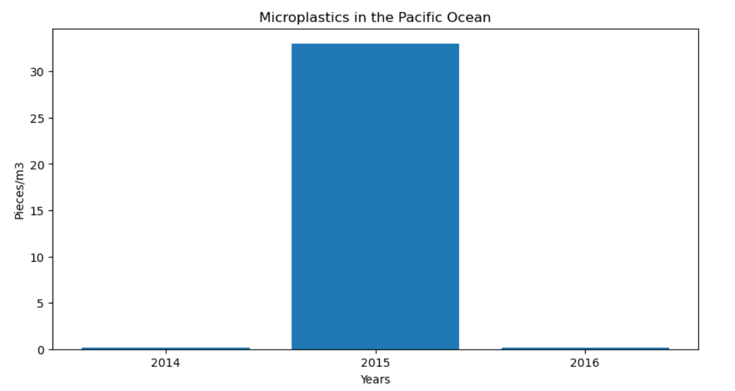
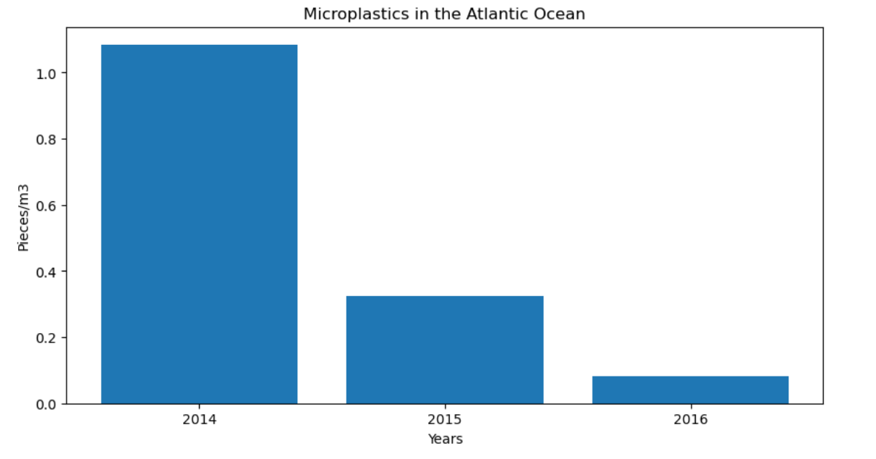
Comparison of rates of microplastics in the Atlantic Ocean vs The Pacific Ocean
pacific_mean= 1.9579
atlantic_mean= 0.0265

Slide 14
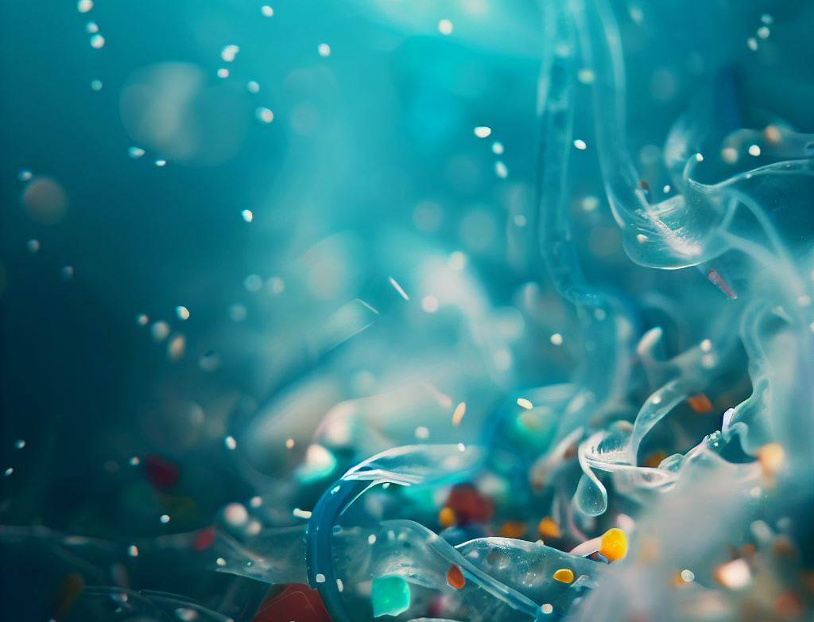
Null and Alternative hypothesis
Null hypothesis: There is no significant difference in microplastic accumulation between the Atlantic and Pacific Oceans.
Alternative hypothesis: Microplastic accumulation is significantly higher in the Atlantic or Pacific Ocean.

Slide 15
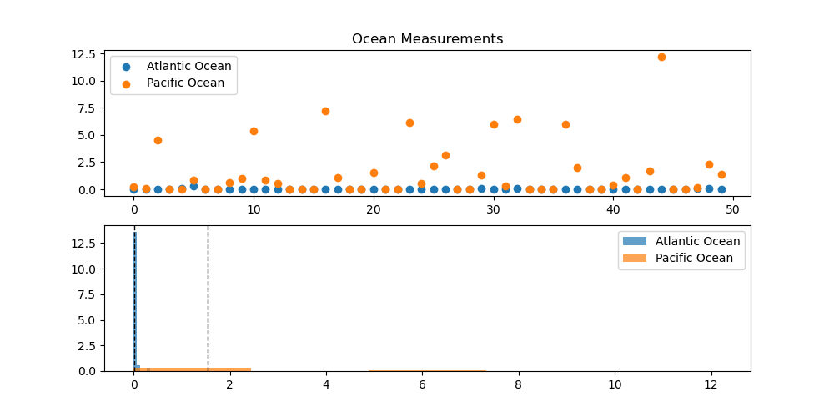
Independent T-Tests
Ttest_indResult(statistic=-4.214879675857894, pvalue=0.00010690516473237953)

Slide 16
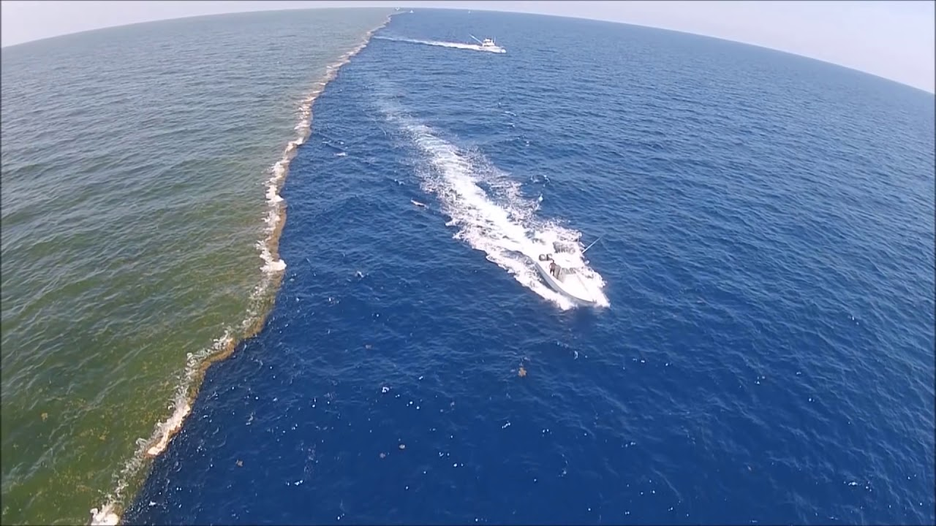
Conclusion
There is strong evidence against the null hypothesis, and the difference in microplastic accumulation between the Atlantic and Pacific Oceans is statistically significant.

